Slide 1
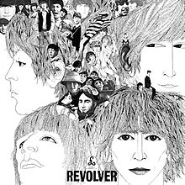
“Taxman” 1966 Revolver Album, The Beatles

Slide 2
August 5, 1966 Protest Song
Written by George Harrison upon discovering that he had entered Britain’s highest tax bracket and would have to pay a 95% (marginal rate)“Supertax”
Harold Wilson – Labour Party Prime Minister leader who introduced the tax
Edward Heath – Conservative Party leader who had nominated the Beatles to become Members of the Order of the Royal Empire (peerage), but who did nothing to protest excessive taxation

Slide 3
Allusion Bridge
George absolutely loved the TV show “Batman.” Can you tell?
During his 1991 tour of Japan, George replaced "Mr. Wilson" and "Mr. Heath" with "Mr. Clinton" and "Mr. Bush," and also altered the bridge: "If you get a head, I'll tax your hat / If you get a pet, I'll tax your cat / If you wipe your feet, I'll tax the mat / If you're overweight, I'll tax your fat."

Slide 4
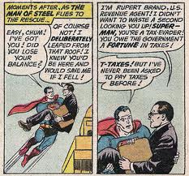

Slide 5
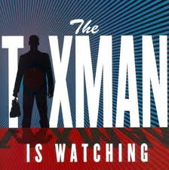

Slide 6
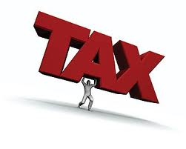

Slide 7
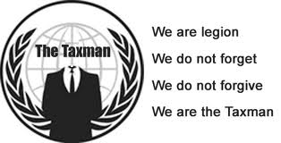

Slide 8
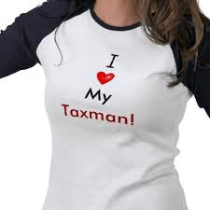

Slide 9
The Truth about Taxes
Pro
Direct taxation promotes democracy
Peoples’ willingness to pay taxes shows that a state is effective
An effective state looks after those in need
An effective state needs a good infrastructure to support growth and the well-being of its people

Slide 10
The Truth about Taxes
Con
Higher taxes encourage tax avoidance
Higher welfare creates dependence and discourages hard work
High taxes discourage entrepreneurship
High taxes act as a drag on the private economy
High taxes deprive consumers of economic liberty

